Slide 1



IILM UNIVERSITY
GREATER NOIDA, UTTAR PRADESH
DATA SCIENCE INTERNSHIP
Iris Flower Classification
Using Machine Learning
PROGRAM & SEMESTER
ORGANIZATION
B.Tech CSE — 7th Semester
OASIS Infobyte
Mahima Shiv Dwivedi | Roll No: CS-2341346 | Batch 2023–27

Slide 2






INTRODUCTION
Objectives & Scope
Flower-species classification is a classic entry point into supervised ML: simple enough to reason about by hand, yet rich enough to demonstrate a complete modelling pipeline on Fisher's 1936 Iris dataset.
Inspect & Validate
Explore Visually
Reason About Features
Confirm dataset integrity — shape, dtypes, missing values, class balance
Understand feature distributions and class separability through EDA
Judge feature usefulness qualitatively, then confirm quantitatively
Prepare Rigorously
Train Diverse Models
Select & Justify
Stratified split + scaling that avoids data leakage
Linear, distance-based, tree-based and ensemble algorithms
Compare on more than accuracy; recommend a best model with evidence
Iris Flower Classification — Data Science Internship
1

Slide 3
DATASET
Dataset Overview
Descriptive Statistics (cm)
150
4
Feature | Mean | Std | Min | Max
Sepal length | 5.84 | 0.83 | 4.30 | 7.90
Sepal width | 3.06 | 0.44 | 2.00 | 4.40
Petal length | 3.76 | 1.77 | 1.00 | 6.90
Petal width | 1.20 | 0.76 | 0.10 | 2.50
Total Samples
Numeric Features
3
0
Balanced Species
Missing Values
Perfectly balanced across species — accuracy is a fair, unbiased headline metric with no majority class to exploit and no need for resampling.
Mean Feature Values by Species
Species | Sepal L | Sepal W | Petal L | Petal W
Setosa | 5.01 | 3.43 | 1.46 | 0.25
Versicolor | 5.94 | 2.77 | 4.26 | 1.33
Virginica | 6.59 | 2.97 | 5.55 | 2.03
Setosa is smallest in petal size but largest in sepal width — a hint that sepal width alone is a weak, counter-intuitive predictor.
Iris Flower Classification — Data Science Internship
2

Slide 4
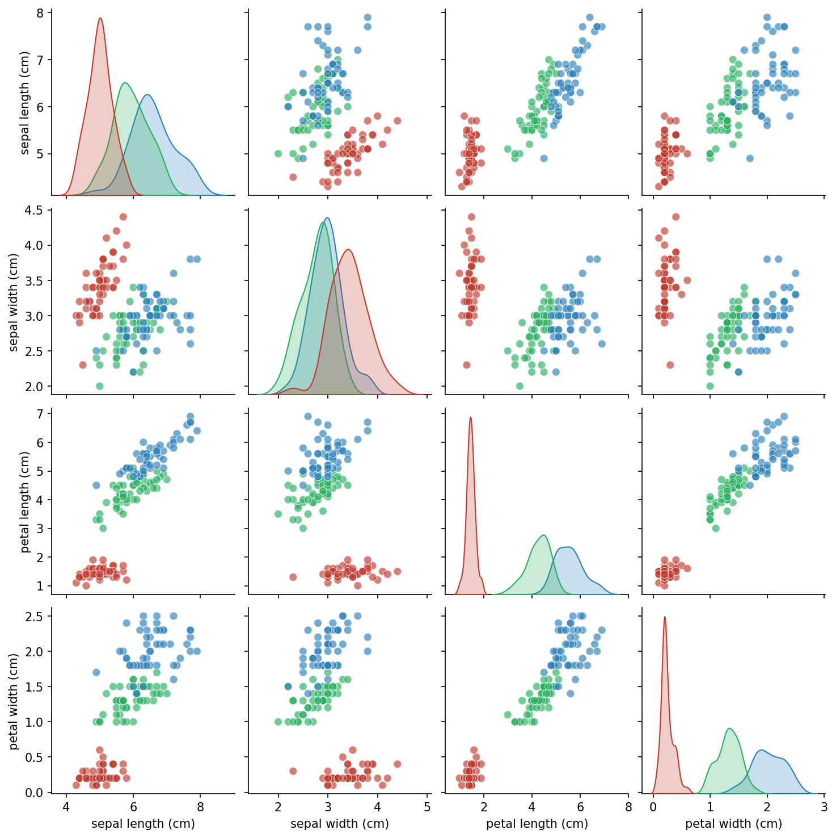

EXPLORATORY DATA ANALYSIS
Pair Plot: Feature Relationships
Setosa is isolated
Forms a tight, completely separate cluster in almost every feature pair.
Petal features separate best
Versicolor and Virginica overlap only modestly, mostly in sepal-based views.
Sepal pairs overlap more
Weaker signal — consistent with lower discriminative ability.
Species legend
Setosa
Versicolor
Virginica
Iris Flower Classification — Data Science Internship
3

Slide 5
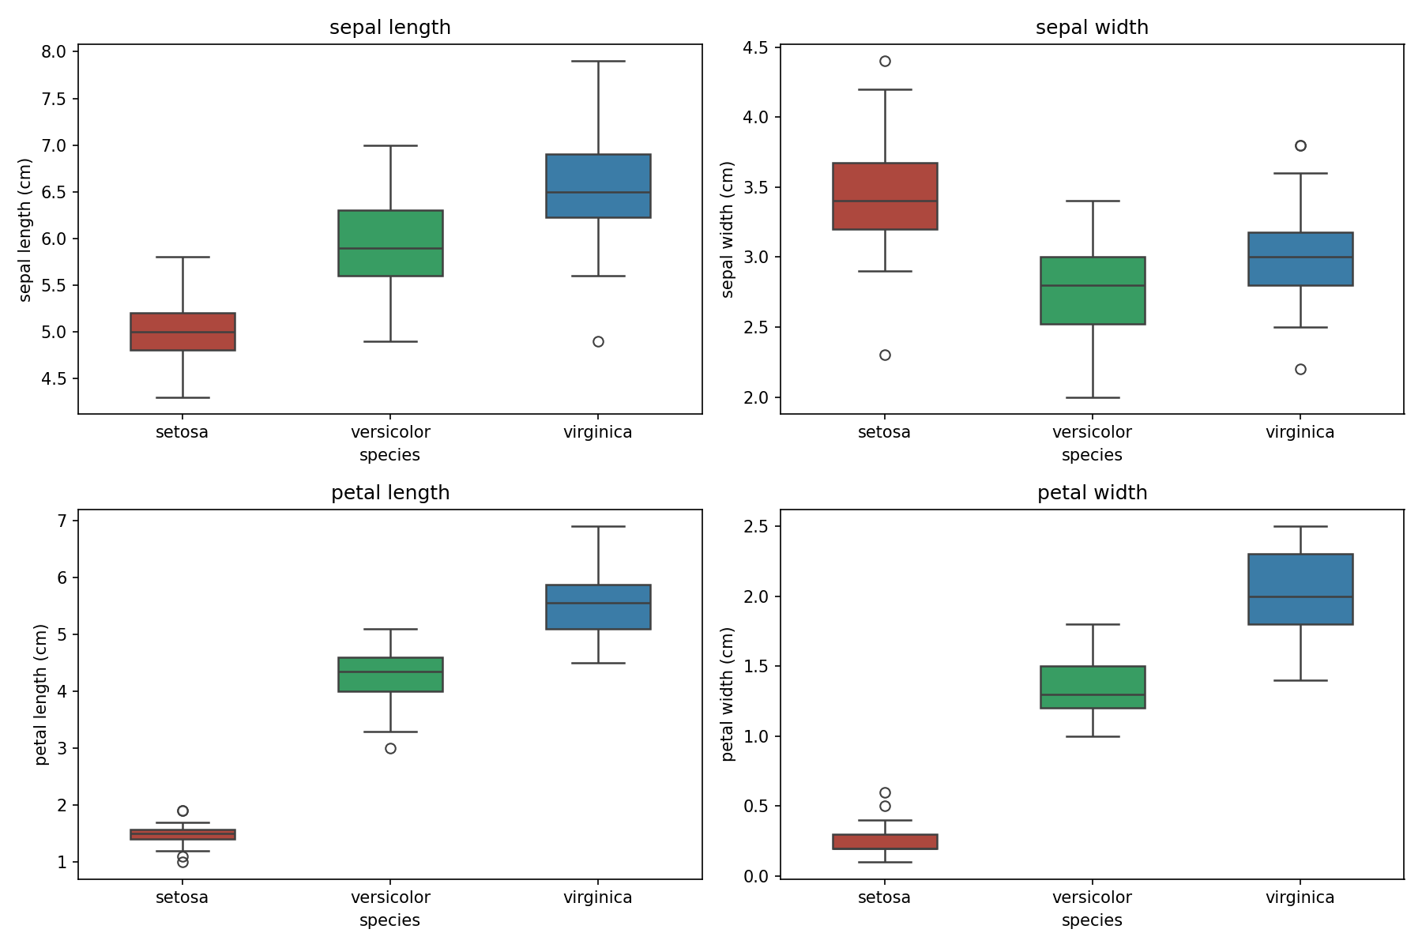
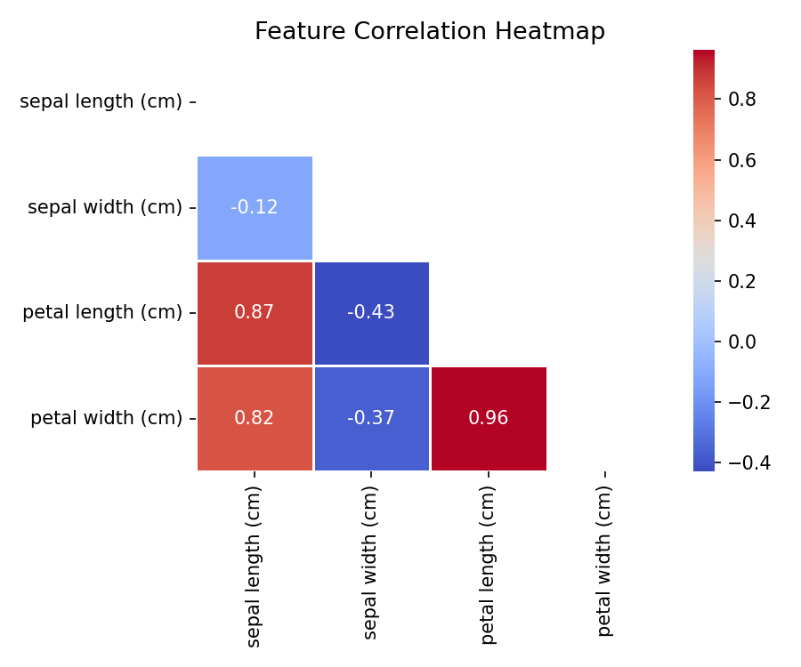
EXPLORATORY DATA ANALYSIS
Box Plots & Feature Correlation
Correlation between numeric features
Petal length/width are strongly correlated with each other and with sepal length. Sepal width stands apart — weak or slightly negative correlation with the rest.
Per-feature spread by species
Iris Flower Classification — Data Science Internship
4

Slide 6
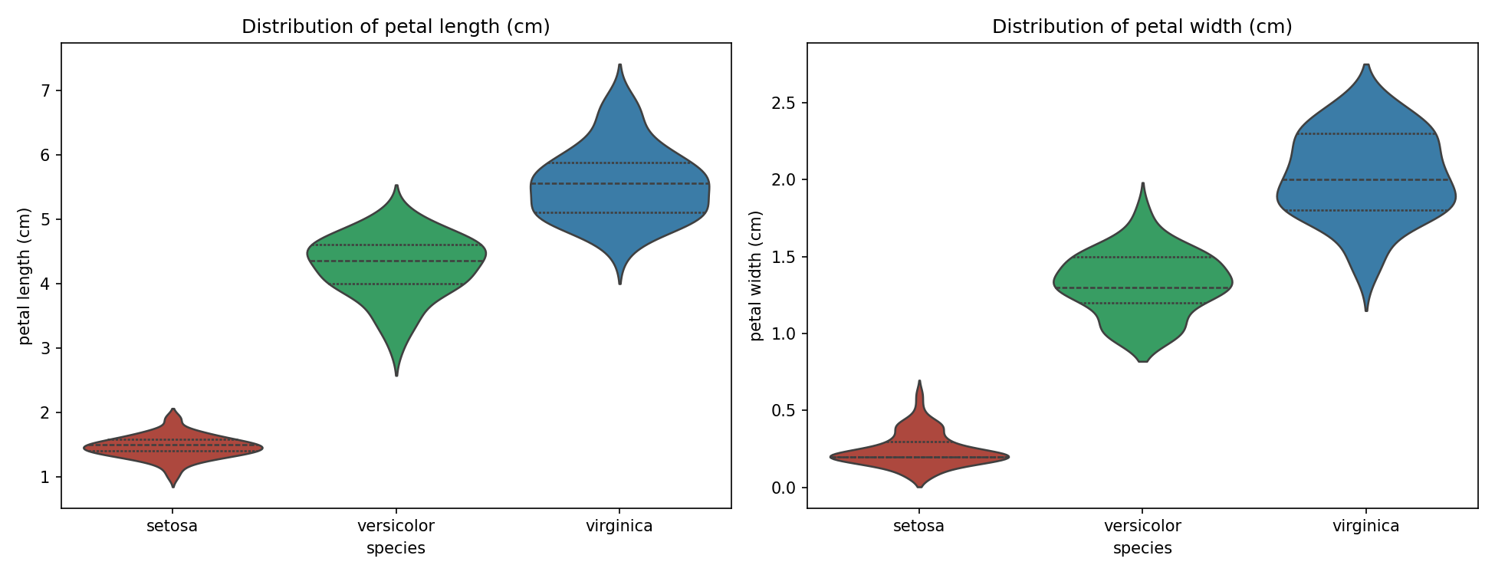
EXPLORATORY DATA ANALYSIS
Violin Plots & EDA Summary
EDA TAKEAWAYS
Setosa is linearly separable on almost every feature
Versicolor / Virginica overlap more, but remain largely distinguishable on petal dimensions
Petal length & width are the most discriminative, correlated pair
Petal length & petal width: three distinct, mostly non-overlapping density regions
Sepal width is the weakest, most independent feature
Iris Flower Classification — Data Science Internship
5

Slide 7
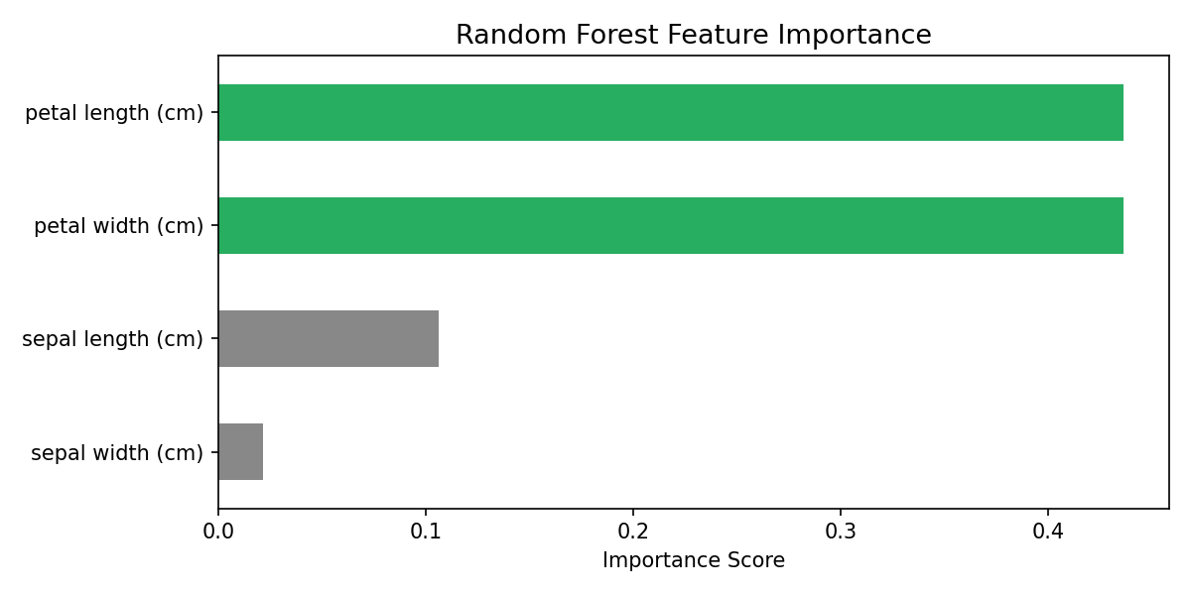
FEATURE SELECTION
Random Forest Feature Importance
Qualitative Feature Assessment
Feature | Ability | Reasoning
Petal length | High | Nearly zero overlap between species
Petal width | High | Tight, well-separated clusters
Sepal length | Moderate | Setosa separates; others overlap
Sepal width | Low | Heavy overlap across all species
Petal length and width together account for ~87% of the model's decision signal. No features were removed — even weak ones can add marginal benefit on a set this small.
Preliminary full-dataset fit, used for analysis only — the held-out train/test split in Section 6 is separate and does not leak information.
Iris Flower Classification — Data Science Internship
6

Slide 8

METHODOLOGY
Data Preparation Pipeline
STEP 1
STEP 2
STEP 3
Split
Standardise
Avoid Leakage
80 / 20 stratified train-test split
z = (x − μ) / σ
No test-set information used to fit the scaler
120 train · 30 test samples, 10 per class in the test set
Scaler fit on training data only, then applied to test data
Critical for KNN (distance-based) & Logistic Regression
Why it matters: without stratification, a single unlucky split could under-represent a class in the test set, making the reported accuracy unreliable on a dataset this small.
Iris Flower Classification — Data Science Internship
7

Slide 9



METHODOLOGY
Four Classification Algorithms
Logistic Regression
K-Nearest Neighbours
Decision Tree
Random Forest
Linear · Baseline
Distance-based
Rule-based
Ensemble
Softmax over a weighted feature sum. max_iter=200. Interpretable coefficients.
Majority vote of k=5 nearest neighbours (Euclidean). No boundary-shape assumptions.
Greedy recursive splits. max_depth=4. Reads directly as if/else rules.
100 trees, max_depth=5, bootstrapped + random feature subsets, majority vote.
All four are trained on the identical scaled training data, so results are directly comparable across four different modelling philosophies.
Iris Flower Classification — Data Science Internship
8

Slide 10
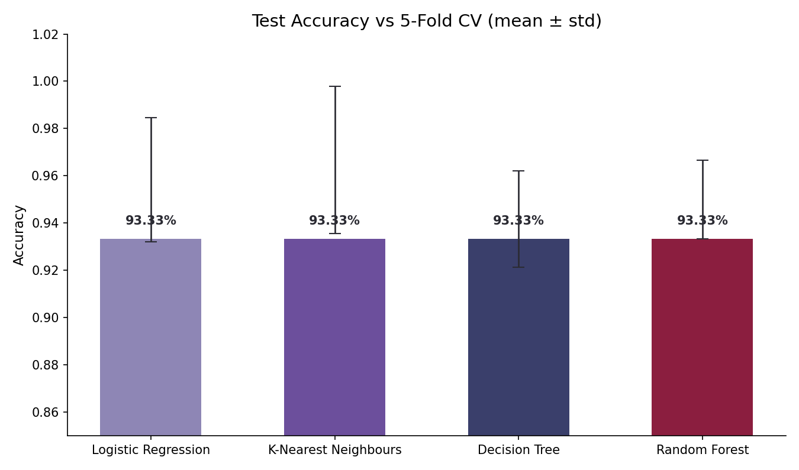
RESULTS
Accuracy & Cross-Validation
Model | Test Acc. | CV Mean | CV Std
Logistic Regression | 93.33% | 95.83% | 0.026
K-Nearest Neighbours | 93.33% | 96.67% | 0.031
Decision Tree | 93.33% | 94.17% | 0.020
Random Forest | 93.33% | 95.00% | 0.017
All four reach an identical 93.33% test accuracy (28/30) — the test set alone can't separate them, so 5-fold cross-validation breaks the tie.
KNN has the highest CV mean (96.67%) but also the most variability (σ=0.031).
Random Forest has the lowest CV std (0.017) — the most consistent across folds.
Error bars show 5-fold CV mean ± std deviation on the training set
Iris Flower Classification — Data Science Internship
9

Slide 11
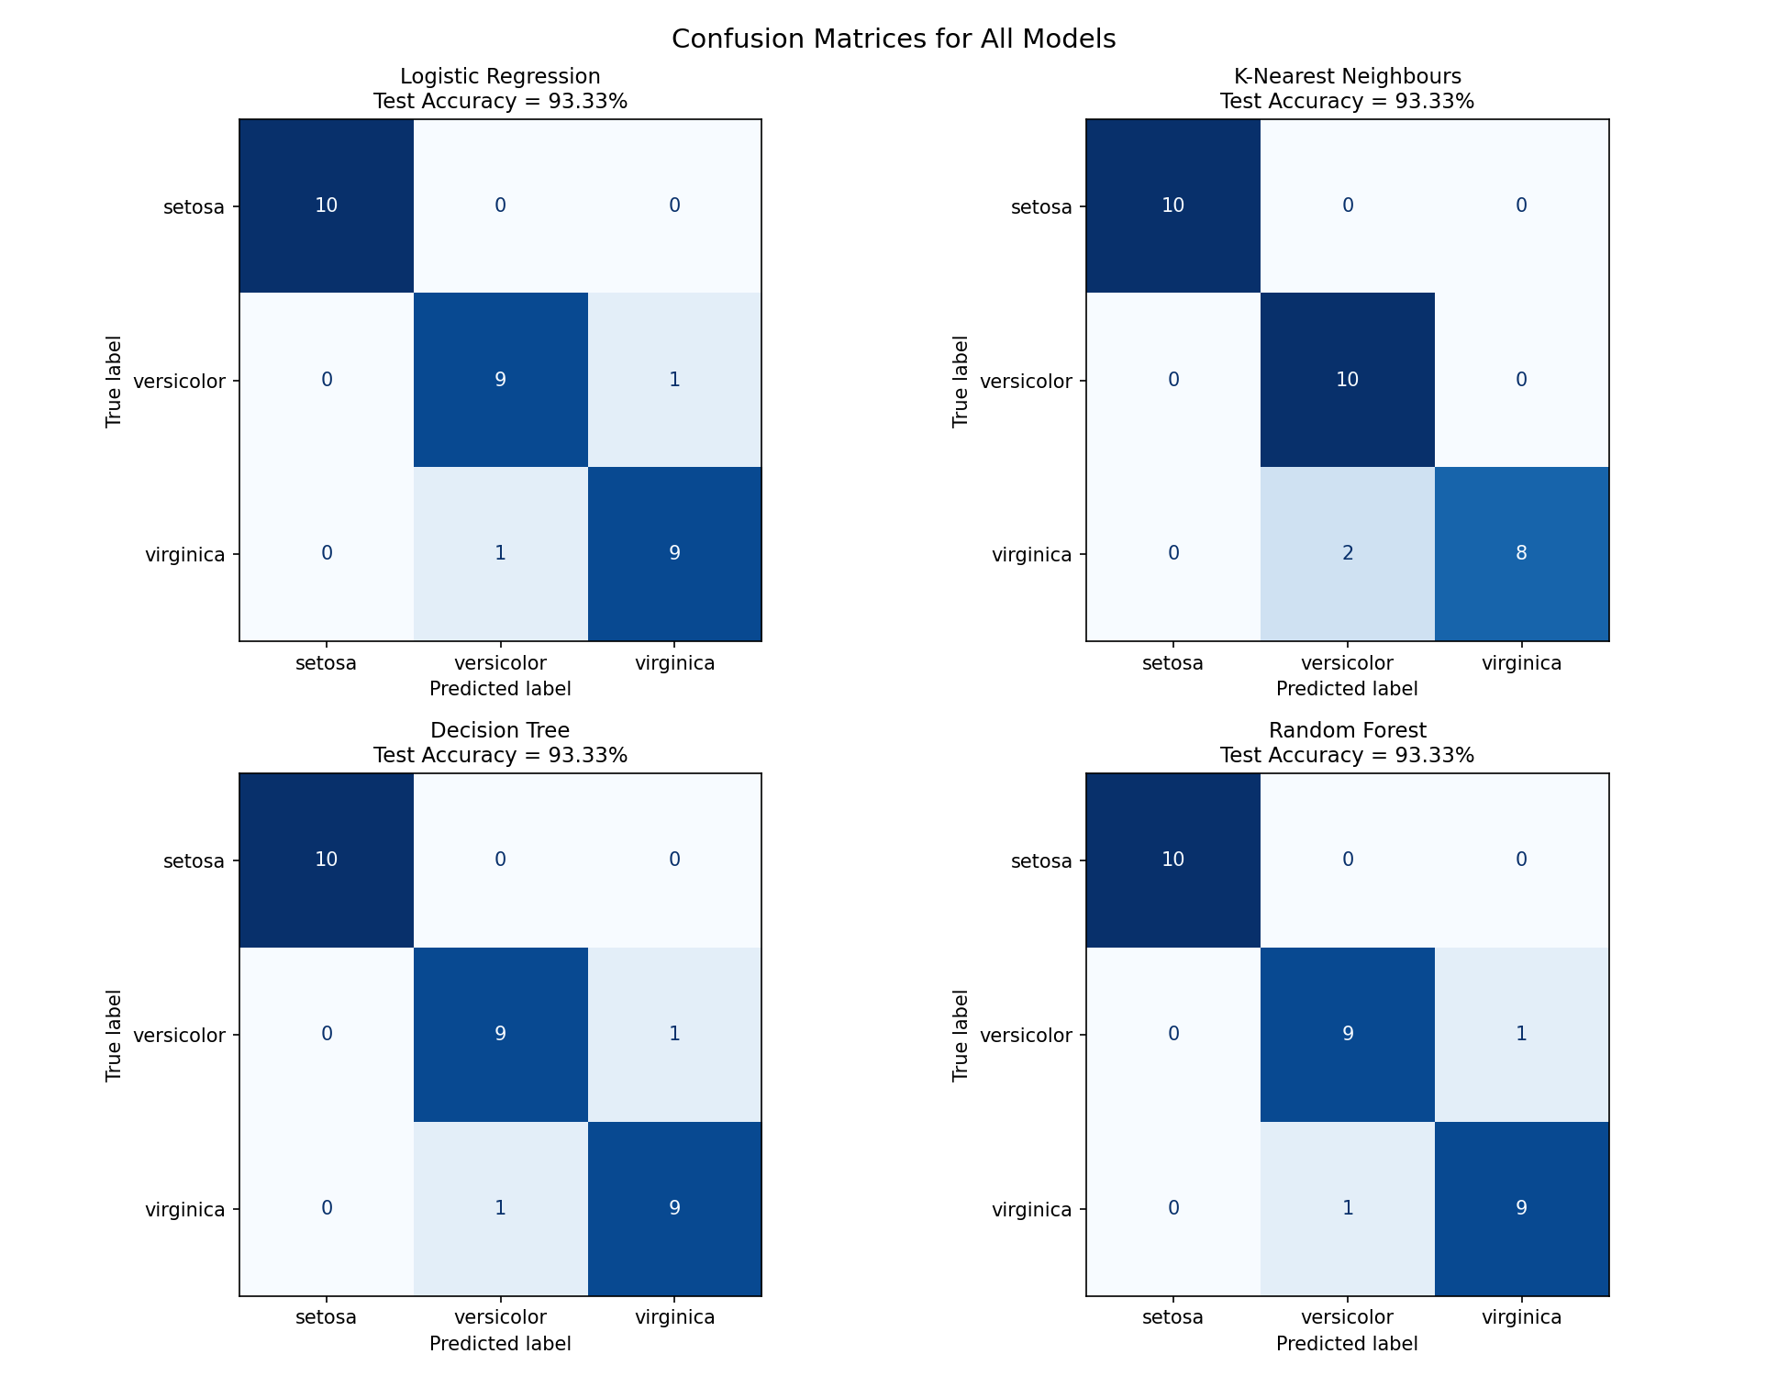

RESULTS
Confusion Matrix Analysis
Setosa: zero errors
All 10 Setosa test samples are classified correctly by every single model.
Only Versicolor ↔ Virginica confusion
Every misclassification, on every model, occurs only between these two species.
KNN errs differently
All 10 Versicolor correct, but 2 Virginica pulled toward Versicolor — a distinct, local-neighbourhood error pattern.
Relying on one aggregate accuracy figure would hide this — the confusion matrix reveals a real behavioural difference between models with identical test accuracy.
Iris Flower Classification — Data Science Internship
10

Slide 12

DISCUSSION
What the Results Really Show
The Iris dataset is close to linearly separable, so even a simple linear model performs on par with more flexible non-linear ones — the ceiling on accuracy is set by genuine overlap between two species, not by model choice.
Two independent angles agree
Feature importance (Sec. 5) and confusion matrices (Sec. 7) both point to the same story: petal measurements dominate, and errors concentrate only between Versicolor and Virginica.
Models differ in behaviour, not accuracy
The real difference between models is how — and how consistently — they resolve the ambiguous Versicolor/Virginica boundary, not their headline test score.
Local vs. global decision-making
KNN's neighbourhood-based predictions produce a qualitatively different error pattern than the other three models, despite an identical test accuracy.
Iris Flower Classification — Data Science Internship
11

Slide 13
CONCLUSION
Best Model: Random Forest
93.33% test accuracy · 0.017 lowest CV std of all models
Joint-highest test accuracy
Most stable across folds
Matches the best score of any model — 28 of 30 held-out samples correct.
Lowest cross-validation standard deviation (0.017) — generalises reliably rather than fitting one split.
Robust to weak features
Transparent at the ensemble level
As an ensemble on random feature subsets, it handles sepal width's low signal without manual elimination.
Feature importance scores explain its decisions — petal dimensions dominate — rather than acting as a black box.
Logistic Regression remains a strong, lightweight alternative — equal accuracy with simpler, directly interpretable coefficients.
Iris Flower Classification — Data Science Internship
12

Slide 14


LOOKING AHEAD
Limitations & Future Work
LIMITATIONS
FUTURE WORK
Small dataset — each of 30 test samples is ~3.3% of accuracy
Systematic hyperparameter search (GridSearchCV) for every model
Headline accuracy comes from a single 80/20 split
Test additional algorithms — SVM, Gradient Boosting
No hyperparameter search — values set by reasonable defaults
Limited to the four classic measurements only
Visualise 2-D decision boundaries on the top two features
Results may not transfer to noisier, real-world data
Repeat across multiple random seeds for a robust estimate
Iris Flower Classification — Data Science Internship
13

Slide 15



WRAP-UP
Tools, Tech Stack & Deliverables
TECH STACK
PROJECT DELIVERABLES
Python 3.10+
File | Description
iris_classification.ipynb | Full notebook — code, analysis, narrative
requirements.txt | Python package dependencies
README.md | Overview, setup instructions, checklist
*.png (7 figures) | Pairplot, boxplots, heatmap, violins, importance, confusion matrices, accuracy chart
Language
pandas · numpy
Data handling
scikit-learn
Machine learning
matplotlib · seaborn
Visualisation
Jupyter Notebook
Development
All figures and numeric results are reproducible from the notebook's exact logic, with a fixed random seed (random_state = 42).
Iris Flower Classification — Data Science Internship
14

Slide 16
Thank You
Questions & Discussion
Mahima Shiv Dwivedi
Roll No: CS-2341346 · B.Tech CSE, 7th Semester
IILM University, Greater Noida

